Slide 1
ONLINE BANKING SYSTEM USING PHP
Presented by
G. BALAMURUGAN -18E1741

Slide 2
CONTENTS
•Abstract
•Introduction
•Modules Description
–Module 1 -ADMIN
–Module 2 - CUSTOMER
–Module 3 - HOME PAGE
•Results and Discussion
•Screenshot
•Plan For Next Month

Slide 3
ABSTRACT
Online Banking is one of the most important financial activities which will be carried out by any person who holds a bank account. Once a user logs in he or she can check the bank balance, check bank account transaction history or account summary, add beneficiary accounts, transfer funds to another account, loan information. Whenever we deal with a banking system main concern should be the security related to banking transactions and account login activity. In the existing system the transactions are done only manually but in the proposed system all the transactions are done through online banking system.

Slide 4
INTRODUCTION
The main objective of the proposed Online banking system project is to be automated the various activities and functions of any bank through Internet. Online banking system project will facilitate to the bank employees and the customers with the different modules. Using the project the bankers and customers can generate various kinds of reports. The banking industry will take a big leap, shape and explore like never before.
Online banking system will manage all details of the existing customers who are registered and allow them to operate their account online via internet.
Online banking system project will provide facility to open new customer account and maintain its data efficiently and effectively.
This project will allow bank admin to view all the details of the existing customer.
Use of the proposed project will make activities like updating, modification, deletion of records easier as compared to the manual process.

Slide 5
COMPONENTS REQUIRED
HARDWARE REQUIREMENTS:
LAPTOP(WINDOWS OS 10)
SPECS NEEDED : 8GB Ram, Quad core processor
SOFTWARE REQUIREMENTS:
Microsoft Visual studio code, Xampp
LANGUAGES USED:
Frontend: HTML,CSS,JAVASCRIPT,BOOTSTRAP
Backend: PHP & MYSQL

Slide 6
MODULE DESCRIPTION
• ADMIN MODULE:
1.Admin Login
2.Add customer and create account
3.Deposit and withdraw money
• CUSTOMER MODULE:
1. Account details
2. Transactions and History
3. Loan
• HOME PAGE:
1. Details of the bank

Slide 7
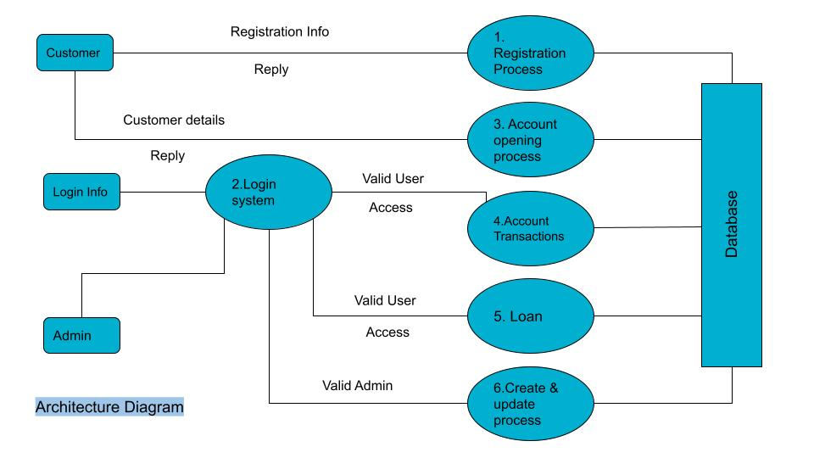
ARCHITECTURE DIAGRAM

Slide 8
ADMIN MODULE
The Bank Account Management System is an application for maintaining a person's account in a bank
To show the working of a banking account system and cover the basic functionality of a Bank Account Management System.
The Administrator can check bank account with a login can work out with A/C holders of the bank can withdraw/ deposit cash to/from their accounts.

Slide 9
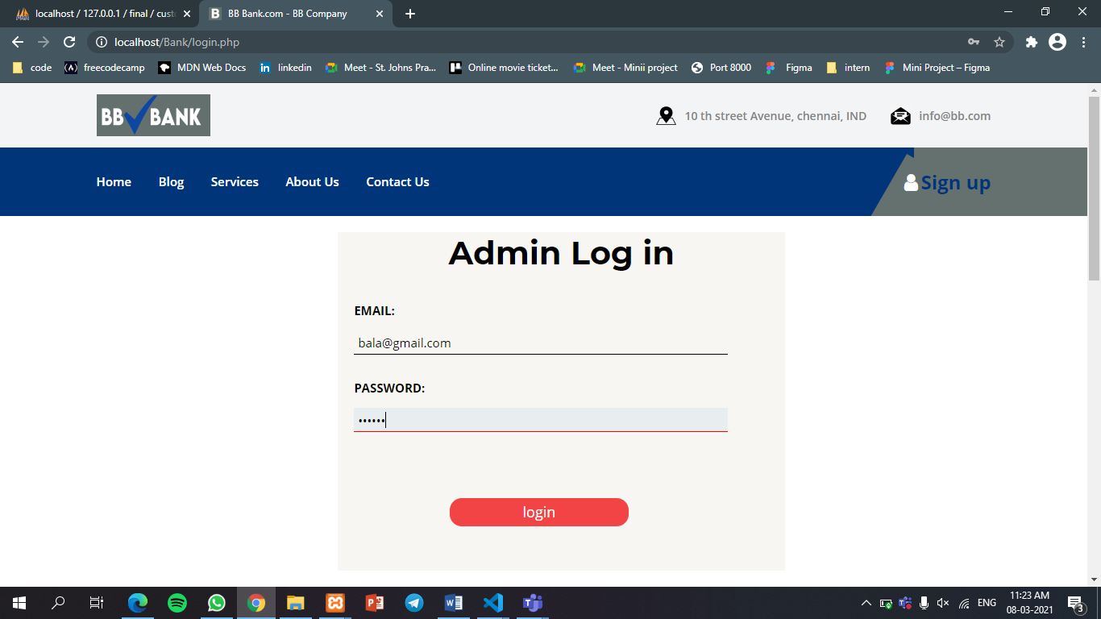
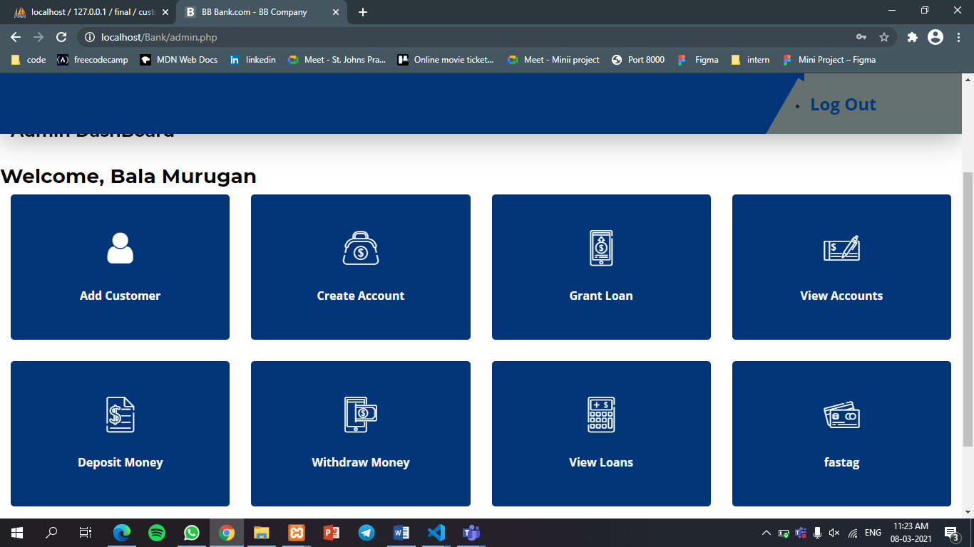
ADMIN

Slide 10
FUTURE WORK
We will make changes and addition of functionality in the admin
We will add the other two modules ie. Customer module and Home page
At last it will be a simple and attractive user interface with all the functionalities.

Slide 11
THANK YOU SO MUCH

